Slide 1

Training of Trainers Program (Bangladesh TVET)
Exploring Web Responsiveness
Responsive designs – using Fluid Grids and Media Queries

Slide 2

What is the web build on?
Typically, the web is build with the help of many tools, frameworks and languages
Below is a link of these resources: http://codecondo.com/15-fantastic-web-development-tools/
Notes:
http://codecondo.com/15-fantastic-web-development-tools/

Slide 3
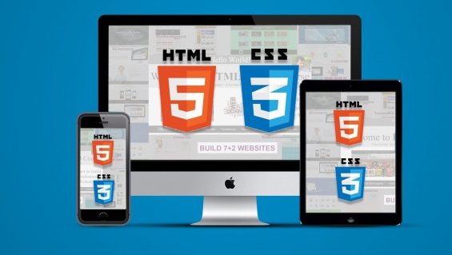
What is the web build on?
For our purpose to teach responsive design, we will narrow down to basic building blocks of the web:
HTML5
CSS3
These are essential to create responsive websites.
Tools such as Javascripts,Bootstraps, Templates , Boilerplates, Frameworks help to make web development more organized and simpler.

Slide 4
IT1322 – Principles of Web Usability Design
Exploring Web Responsiveness
Current problem with web design
- many devices, different layouts
Solution
- Create a responsive design website
Responsive Design Explained in 1 min :
https://www.youtube.com/watch?v=jiqugSFUddQ
Notes:
Responsive design is more than a buzz phrase at the moment. It's the answer to particularly vexing problems increasingly facing web designers. The problem is the ever-growing number of Internet capable screens of varied widths and heights, many able to swap dimensions with the flip of a wrist. Before we get into a more or less formal definition of responsive design, let me show it to you in action, practically applied.

Slide 5
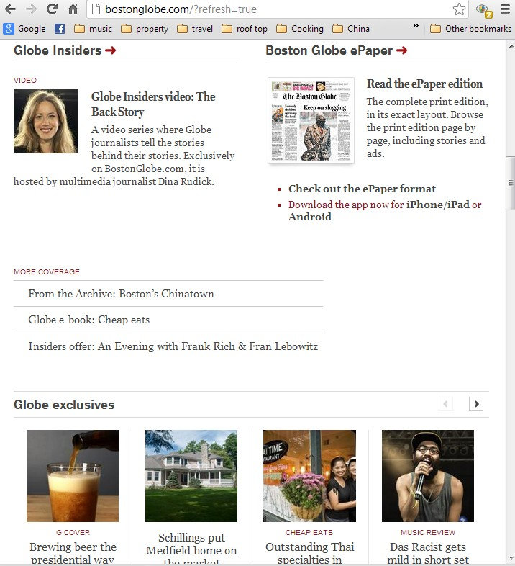
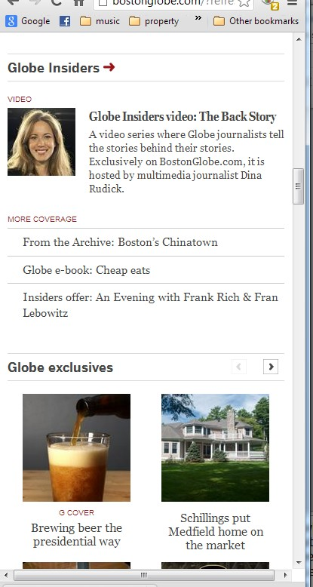
Exploring Web Responsiveness
Example:
Example site: http://bostonglobe.com
Notes:
Here's the Boston Globe site, http://bostonglobe.com and like many newspaper websites, it's laid out in a series of columns.
So watch what happens as I start to make the window smaller by dragging it in from the right. You can see things begin to shift around, but they largely stay in the same proportion. The columns are basically all the same width, and once we get to a certain point, however, the entire layout shifts. Now we have two major columns up top and two columns there We still have our four columns. Let's continue to move in, and now it's shifted again, so we have our two big columns and single columns here.
At a smaller window, the main column takes over the layout entirely, so where did the sidebar go? Well, if you scroll down, it's listed also in a full column, and it's gotten much bigger. So now not only did they move the sidebar, but they really have re-emphasized it. So, one of the things that you can do with responsive layouts is to shift your layout design around so that it makes sense for the people who are looking at it in a particular

Slide 6
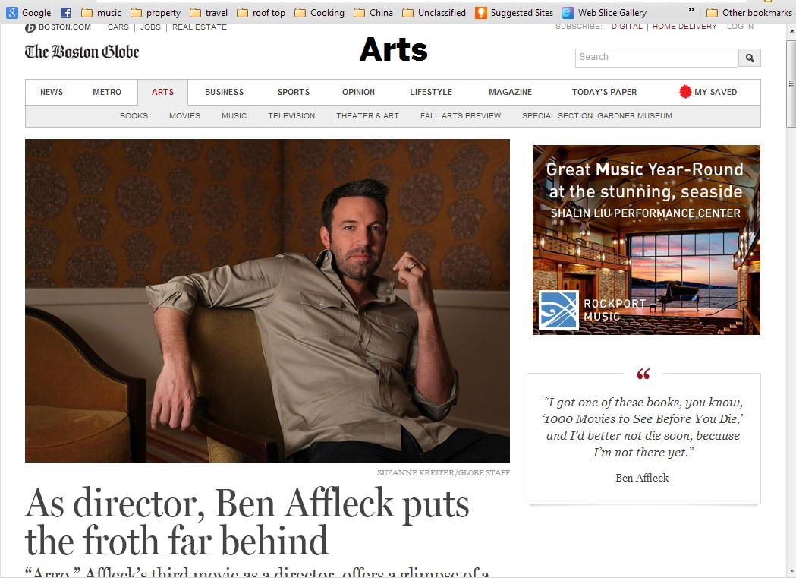
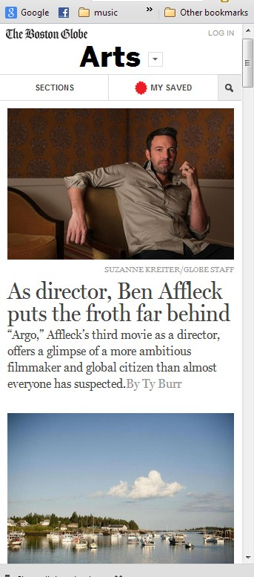
Exploring Web Responsiveness
Example:
Notes:
Notice even the image is replaced with an optimized out for smaller layouts. Switch from double to single layout

Slide 7
Exploring Web Responsiveness
Conceived to meet challenge of multiple devices with difference screen sizes
Was First discussed by Ethan Marcotte, in A List Apart.
Responsive Web Design has two Main Components:
  Fluid Grid
  Media Queries
Notes:
The term responsive web design and the philosophy behind it came from an article in A List Apart written by Ethan Marcotte. Ethan is far more than a theoretician. He was the primary consultant who worked with the Boston Globe on their redesign hat we were just looking at.
The primary takeaway is that responsive web design has two key components, fluid grids and media queries.

Slide 8
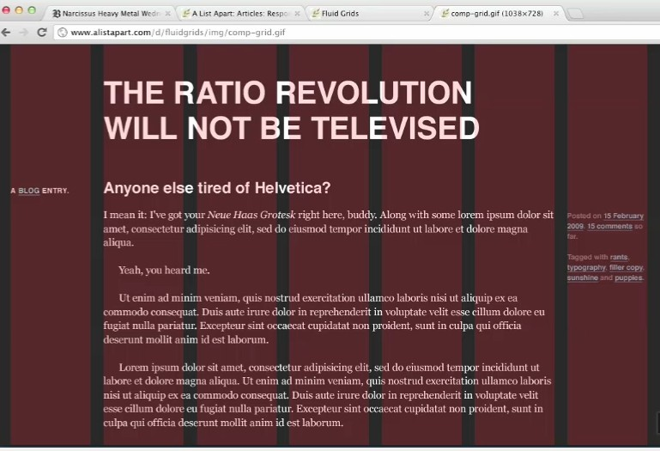
Exploring Web Responsiveness
Notes:
Fluid Grid Example
that the first and last columns are confined to the width of a single column, while the main content in the center takes up the five columns. The other aspect of the grid, that's a bit obvious, but so important that I have to mention is consistency. Both the columns and the spaces between the columns, the margins, are a consistent width across the page. The width adjustment is handled through CSS, which uses percentages for a declared width. Now there's a whole mathematical formula behind the concept of fluid grids.

Slide 9
Responsive Design – What and Why?
Responsive design is the process of arranging the layout in a way that all the important information is presented in a user readable way in any kind of device or screen size.
Most designers will choose a grid based layout since it’s easier to handle grid based layouts in different kind of devices.
It’s your decision to choose between a fixed or fluid grid to design the layout. In this week practical, we are going to focus on fluid grids and their importance in responsive design.

Slide 10
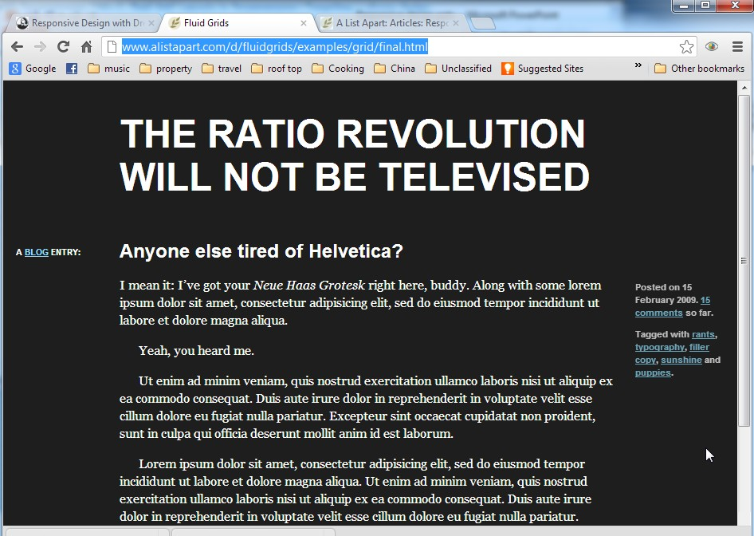
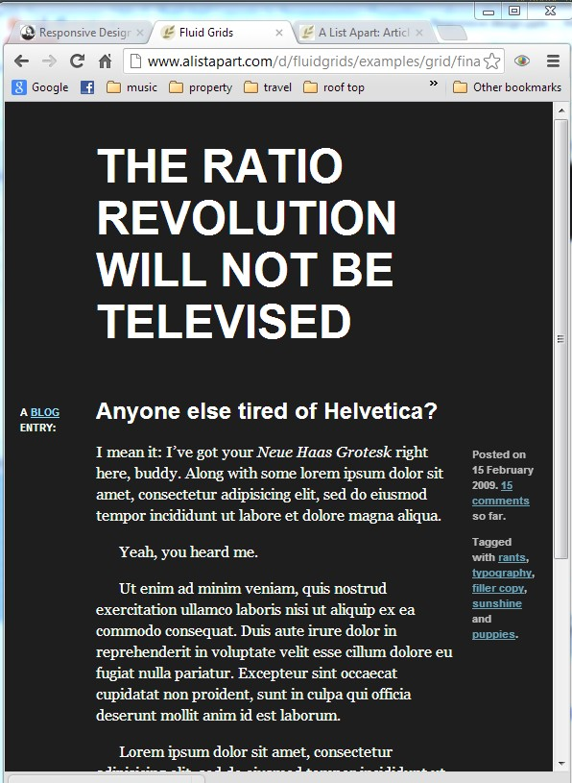
Responsive Design
Notes:
Fluid Grid Example
Now notice that again when we resize the webpage with the browser, the columns are getting smaller, but they're maintaining the same proportions. Now if I continue to go in, you can see we start to get into problems, and that's because this is just the fluid grid concept, this is not the other part of responsive web design incorporated, but as a fluid grid, it does work very well up to a certain point.
http://www.alistapart.com/d/fluidgrids/examples/grid/final.html

Slide 11
Fixed vs. Fluid vs. Adaptive vs. Responsive
https://www.youtube.com/watch?v=T6MCkGWSXa0
Watch this video for a better understanding of Fluid Grid vs Fixed Grid
And how Adaptive and responsive design defers.

Slide 12
Fluid Grid vs Fixed Grids
FIXED GRIDS
A fixed website layout has a wrapper that is a fixed width, and the components inside it have either percentage widths or fixed widths. The important thing is that the container (wrapper) element is set to not move. No matter what screen resolution the visitor has, he or she will see the same width as other visitors
Notes:
You will find out more about fluid grids in the practical 4.

Slide 13
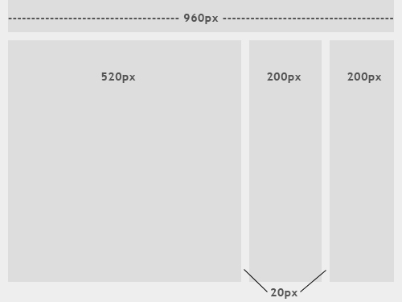
Fixed Grid Layout
The image on the left shows the general outline of a fixed-width website layout. The components inside are fixed to 520, 200 and 200 pixels, respectively. A 960-pixel width has become the standard in modern Web design because most website users are assumed to browse in 1024×768 resolution or higher.

Slide 14
Fluid Grids
FLUID GRID
In a fluid website layout, also referred to as a liquid layout, the majority of the components inside have percentage widths, and thus adjust to the user’s screen resolution.

Slide 15
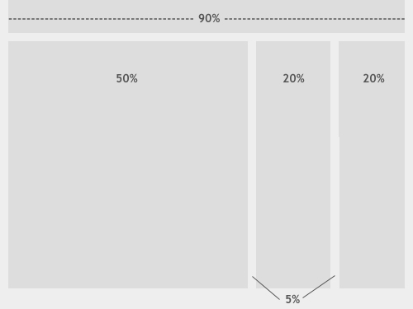
Fluid Grid
The image above shows a fluid (liquid) website layout. While some designers may give set widths to certain elements in fluid layouts, such as margins, the layout in general uses percentage widths so that the view is adjusted for each user.

Slide 16
Responsive Design – Media Queries
Media Queries
A Media Query is a recognized value of the media attribute that allows specific CSS rules or external style sheets to be applied conditionally, like if the current device has a screen of a certain width.
Notes:
A media query can be stated within a link to an external style sheet via the media attribute, or it can be included in an @media rules. They give you the power to create sites that--like the Boston Globe--present a different layout for differently sized screens (and/or different devices).
Defined in the CSS3 spec : A Media Query is a recognized value of the media attribute that allows specific CSS rules or external style sheets to be applied conditionally, like if the current device has a screen of a certain width.

Slide 17
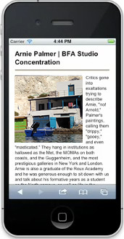
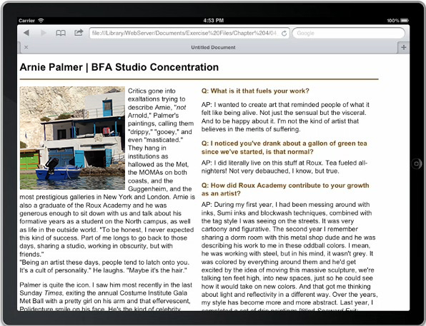
Responsive Design – Media Queries
Different Devices, Different CSS Rules
Notes:
You can, for example, start out with a basic Desktop design, and then you can set up one set of CSS rules that are applied if the width of the display screen is at a minimum 768 pixels, like an iPad or other Tablet, and establish another set of CSS rules that kick in when the screen is at least 320 pixels, like an iPhone. There is no limit to the number of Media Queries you can establish, that's totally up to you.

Slide 18
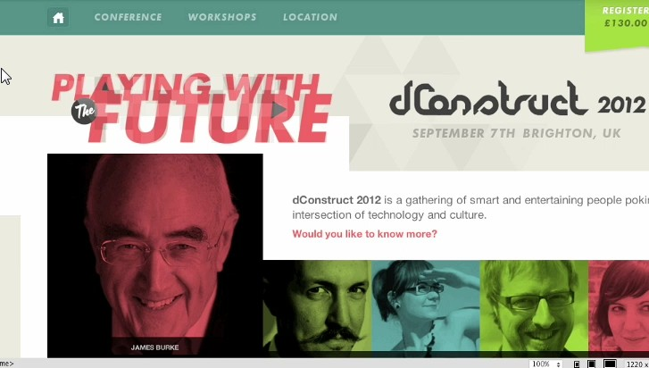
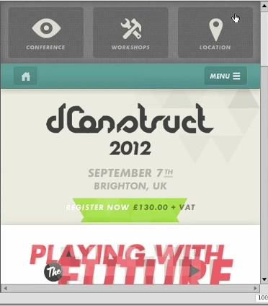
Responsive Design – Media Queries
Different Devices, Different CSS Rules
Notes:
First imaage – desktop view.
Second image – small devices/mobile device view
Notice in the menu – Conference/Workshops/location is different for different platforms
This can be done through CSS

Slide 19
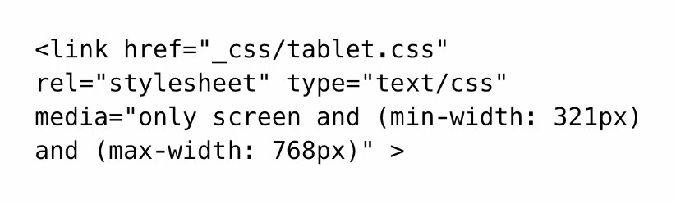
Responsive Design –
Method 1 - Using Media Attribute
Specifying Size within the Media Attribute
Eg. 1
Notes:
Here's the code to pull in a style sheet for standard Tablet. Note the min-width and max-width name value pairs within the media attribute. The min-width and max-width properties are supported across all modern browsers that you'll find on Mobile devices. There are other conditional media attributes, like orientation, as well. You don't always have to work with external stylesheets.

Slide 20
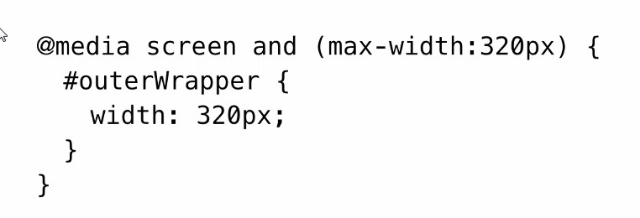
Responsive Design –
Method 2 - Using @Media Queries in css
Example coding in your CSS file:
Media Queries – Using Media Attribute
Notes:
Using the @media rule you can conditionally apply properties and values. Here's the code for adding styles to a small size screen in an @media rule, and finally, you should keep in mind that Media Queries can be used for many things, not just overall page layout.

Slide 21
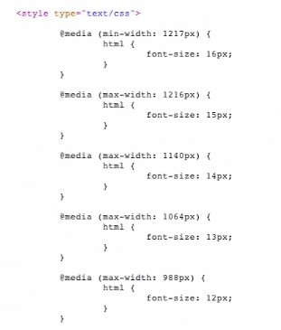
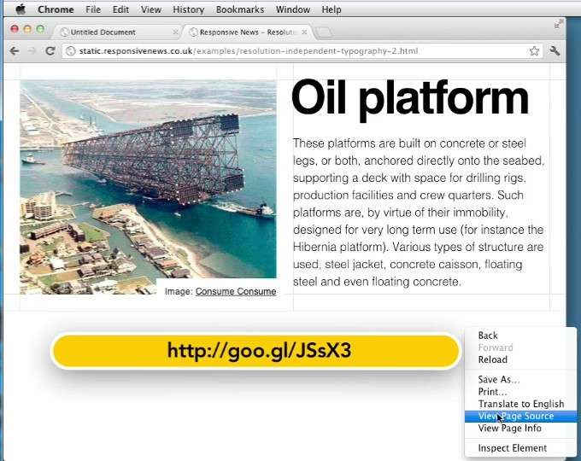
Responsive Design – Media Queries Eg 1
Different Media Queries for different devices
Notes:
If we take a look at the Source Code here, we can see that designer Mark Hurrell used nine different Media Queries in order to address the text sizing issues that I just showed you.

Slide 22
Responsive Design – Media Queries Eg 2
The @media rule allows different style rules for different media in the same style sheet.
<head>
<style>
@media screen
{
p.test {font-family:verdana,sans-serif;font-size:14px;}
}
@media print
{
p.test {font-family:times,serif;font-size:10px;}
}
@media screen,print
{
p.test {font-weight:bold;}
}
</style>
</head>
The style in the example below tells the browser to display a 14 pixels Verdana font on the screen. But if the page is printed, it will be in a 10 pixels Times font. Notice that the font-weight is set to bold, both on screen and on paper:

Slide 23
Typical Media Query Standards
Research to see the standard media queries used for latest devices.
Google: css media queries for common devices
A typical css media queries template looks like this:
/* All Smartphones in portrait and landscape ----------- */
@media only screen and (min-device-width : 320px) and (max-device-width : 480px) { /* YOUR STYLE GOES HERE */ }
/* All Smartphones in landscape ----------- */
@media only screen and (min-width : 321px)
{ /* YOUR STYLE GOES HERE */ }
/* All Smartphones in portrait ----------- */
@media only screen and (max-width : 479px) { /* YOUR STYLE GOES HERE */ }
/* Desktops and laptops ----------- */
@media only screen and (min-width : 1224px) { /* YOUR STYLE GOES HERE */ }
/* Large screens ----------- */ @media only screen and (min-width : 1824px) { /* YOUR STYLE GOES HERE */ }
Notes:
Here are some examples of media queries for different devices

Slide 24
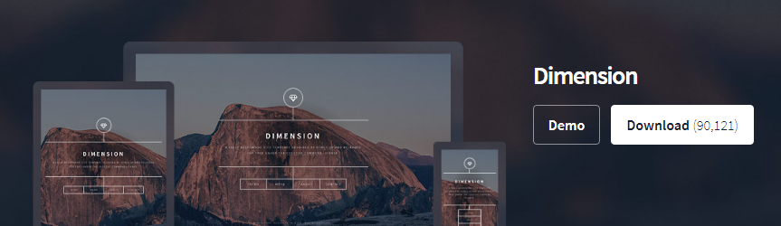
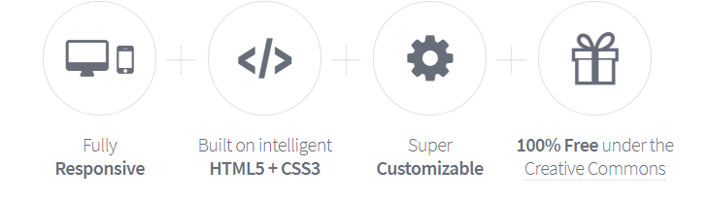
Responsive Web Templates
Besides using standard css media queries, you can build a website using responsive web templates (usually built on HTML5 and CSS3), available online:
https://html5up.net/
https://templated.co/
These templates come with the CSS media queries that cater to most devices.

Slide 25
Summary
There are many evolving standards to help you in responsive design to support different layouts.
These may be device / browser specific or it could be a generic CSS/CSS3 standard.
Some standards may become deprecated.
Constant check and updates by the developer is required, in view of these evolving standards, and emerging devices.
Basically, a combination of design methods is the best solution. Eg. Employing fluid grids with @Media queries in your CSS + meta tag controls such as “Viewport”,etc.

